Slide 1
LOLA: LLM-Assisted Online Learning Algorithm for Content Experiments
Ye, Yoganarasimhan, Zheng | Marketing Science, 2025
Replicated and Presented by Xizhi Liu and Shaoqiang Liu | DOTE6635, 2026
Digital content consumption is growing at an unprecedented pace, creating both opportunities and challenges for media firms. In this hyper-competitive landscape, publishers must continuously identify the most appealing articles, craft the most attractive headlines, and design the most engaging packaging to capture audience attention. The key metric driving these decisions is Click-Through Rate (CTR) — a critical measure of how effectively headlines convert impressions into clicks.
This research explores whether Large Language Models (LLMs) can revolutionize how media companies conduct content experimentation, potentially reducing costs while maintaining or improving the quality of headline selection.

Slide 2
Traditional Approaches to Content Testing
A/B Testing: Explore-and-Commit
Online Learning: Bandit Algorithms
The traditional A/B testing framework uses fixed traffic allocation across treatment arms. After an exploration phase, the publisher commits to the best-performing arm. This approach is widely used throughout the publishing industry, exemplified by platforms like the New York Times ABRA system and Upworthy’s headline testing methodology.
Modern online learning approaches use multi-armed bandit algorithms that dynamically allocate traffic based on past performance, content features, and uncertainty quantification. Major platforms like Yahoo News and the New York Times have implemented contextual bandit frameworks.
Advantages
Advantages
Lower regret compared to traditional A/B tests
Gradually reduce exploration as performance becomes clear
Faster convergence to best-performing arms
Continuous optimization without discrete phases
Statistically unbiased estimates
Reliable inference with sufficient traffic volume
Simple interpretation for stakeholders
Well-understood statistical properties
Limitations
Limitations
Cold-start problem: arms initialized as equally good
Early traffic potentially wasted on inferior options
Risk of converging to suboptimal arms
Designed for large-traffic regimes, not limited horizons
Equal traffic allocation to poor-performing arms
High regret during exploration phase
Particularly problematic for short-lived content like news articles
Requires large sample sizes for statistical power

Slide 3
Core Research Questions
1
Can LLMs directly predict which headline is most appealing?
2
Can LLMs reduce experimentation
costs?
3
Can LLMs replace traditional
experiments entirely?
Is it possible to leverage the semantic understanding capabilities of large language models to predict human preferences without extensive experimentation?
Can LLM-assisted methods achieve comparable or better performance than traditional approaches while requiring fewer impressions and less traffic allocation to inferior options?
Is there a scenario where LLM-based prediction becomes sufficiently accurate that it obviates the need for A/B testing or bandit algorithms altogether?
Dataset: Upworthy Headline Experiments (2013–2015)
17,681
The researchers analyzed headline testing data from Upworthy, a digital media company known for its rigorous experimentation practices. The original dataset contained 32,487 A/B tests across 150,817 packages, with 538 million impressions generating 8.18 million clicks. After filtering to headline-specific tests, the analysis focused on 17,681 tests covering 77,245 headlines with 277 million impressions and 3.74 million clicks. The average CTR across all tests was 1.52%, with an average of approximately 4.37 headlines per test.
A/B Tests
Headline-specific experiments
77,245
Headlines
Unique headline variants
The prediction task was straightforward: for each A/B test, identify the headline with the highest observed CTR. The data was split into 70% training, 10% for hyperparameter tuning, and 20% for testing to ensure robust evaluation of model performance. Specifically, in this section, there were 12,376 headline tests as a training set and 3,263 headline tests as a test set.
277M
Impressions
Total display occurrences
3.74M
Clicks
Observed user actions

Slide 4
Pure LLM-Based Methods Evaluated
The researchers systematically evaluated three distinct LLM-based approaches.
We replicated and extended the original evaluation using the latest GPT models and reported partial results. See the GitHub repository for implementation details and additional findings: https://github.com/GHCharlesLau/AI-for-research-nexusAI
Prompt-Based Approaches
Direct interaction with LLMs through carefully crafted prompts, testing both zero-shot and in-context learning variants.
1
Zero-shot prompting: LLM directly asked to identify catchiest headline
In-context learning: Demonstrations provided before query
Role prompting: LLM assigned specific expert persona
Temperature and formatting controls
Embedding-Based CTR Prediction
Using LLM-generated embeddings as input features for supervised machine learning models.
2
OpenAI embedding models (256-dim and 3072-dim)
Linear regression with embedding features
Multilayer perceptron (MLP) architectures
End-to-end CTR prediction framework
Fine-Tuned LLM
Custom training of LLM on headline prediction task.
3
Full model fine-tuning on labeled dataset
Task-specific architecture modifications
Hyperparameter optimization
Comprehensive performance evaluation

Slide 5
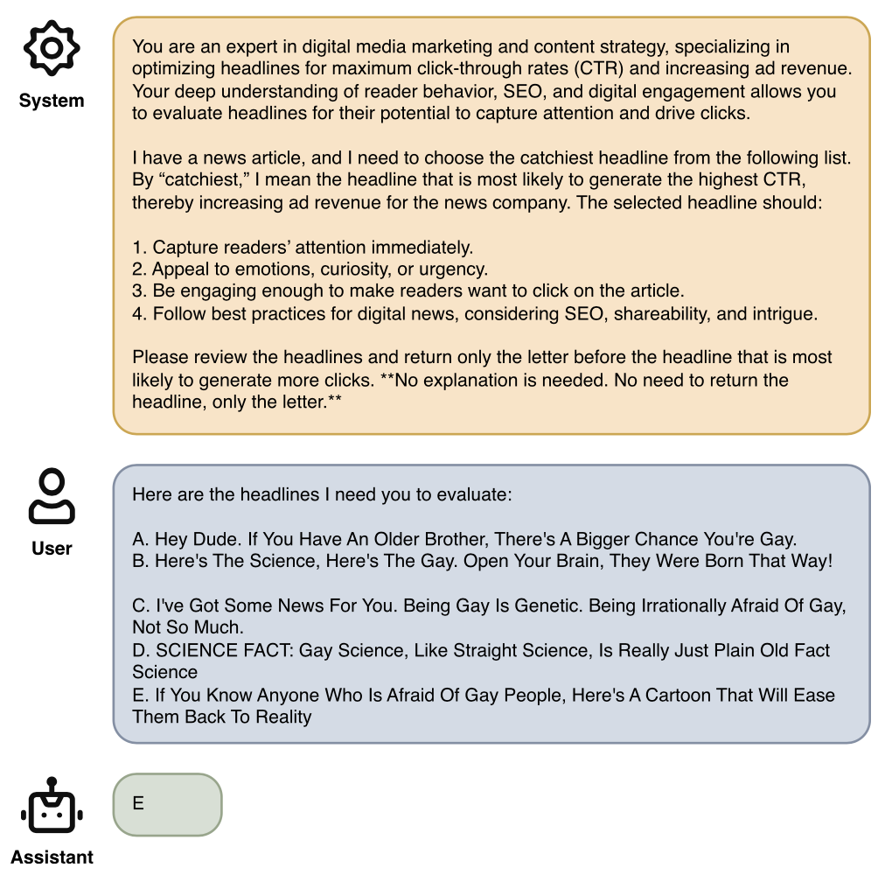
Prompt-Based Method 1: Zero-Shot Prompting
The first prompt-based approach tested was zero-shot prompting, where the LLM is directly asked to identify the catchiest headline without any prior examples or demonstrations. The prompt structure was straightforward: "Which headline is the catchiest?" The researchers also experimented with role prompting, where the LLM was assigned the persona of a marketing expert to see if this improved performance.
Experimental Controls
Temperature set to 0 for deterministic outputs
Randomized order of headline options across tests
Different marker types (letters, numbers, symbols)
Multiple model versions tested
Models Tested
We replicate the original evaluation on:
GPT-3.5
GPT-4
GPT-4o
and extend the analysis to include:
GPT-5.2

Slide 6



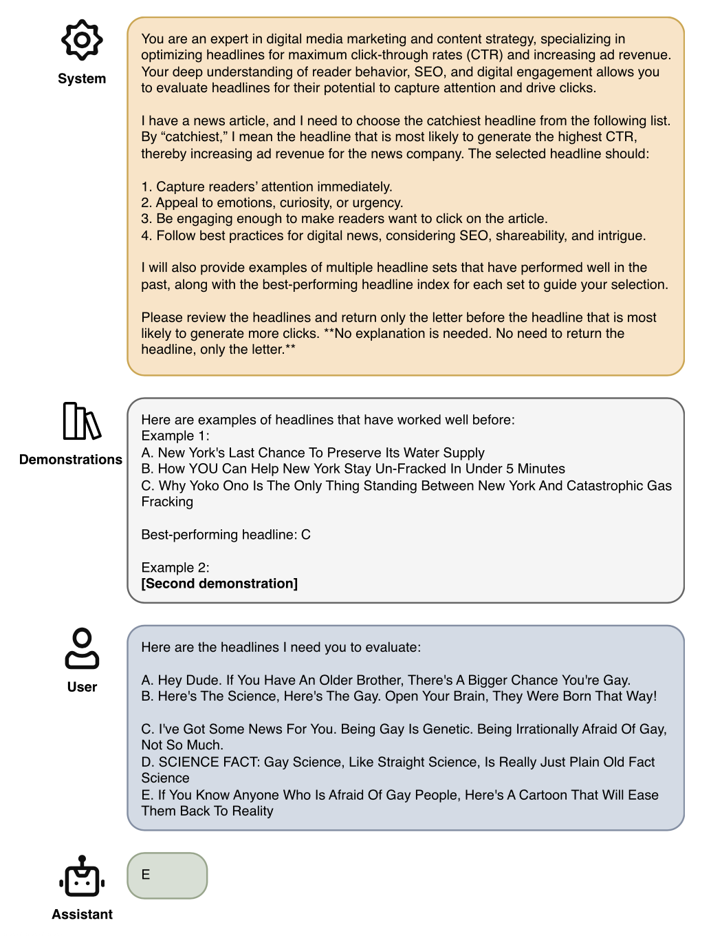
Prompt-Based Method 2: In-Context Learning
The second prompt-based approach tested was in-context learning, where the LLM is provided with demonstrations before the actual query. This approach tests whether showing examples of headline sets and their correct winners helps the model learn the underlying task structure and improve prediction accuracy.
Demonstrations
Learning
Prediction
Example headline sets with labeled winners provided as context
Model learns format and task structure from examples
Applies learned patterns to new headline sets
Experimental Variations
Number of demonstrations: 2 examples vs. 5 examples
Label correctness: Correct labels vs. intentionally incorrect labels
Example selection: Random vs. curated demonstrations
Formatting: Consistent structure across all demonstrations
Models Tested
GPT-3.5
GPT-4
GPT-4o
GPT-5.2

Slide 7
Prompt-Based Results
Results for Prompt-Based Approaches with Different GPT models, the Number of Demonstrations, and Whether We Intentionally Provide Incorrect Solutions in the Demonstration
Model | n_{demo} | Incorrect label | Accuracy (%)
Random guess | — | — | 33.02
GPT-3.5 | 0 | — | 29.76
GPT-3.5 | 2 | 0 | 34.23
GPT-3.5 | 2 | 1 | 31.60
GPT-3.5 | 5 | 0 | 30.95
GPT-3.5 | 5 | 1 | 30.59
GPT-4 | 0 | — | 37.85
GPT-4 | 2 | 0 | 39.96
GPT-4 | 2 | 1 | 38.77
GPT-4 | 5 | 0 | 39.17
GPT-4 | 5 | 1 | 38.28
GPT-5.2 | 0 | — | 40.82
GPT-5.2 | 2 | 0 | 41.62
GPT-5.2 | 2 | 1 | 40.73
Main Takeaways
Performance improves with model scale (GPT-3.5 → GPT-4 → GPT-5.2), but remains capped at around 42%.
GPT-3.5 performs at or below random guess, whereas GPT-4 and GPT-5.2 consistently outperform it.
In-context learning slightly improves performance over zero-shot prompting.
Increasing demonstrations from 2 to 5 does not meaningfully improve accuracy.
Providing incorrect labels in demonstrations has little effect on performance.
Even the best-performing configuration remains only moderately above random guess.

Slide 8


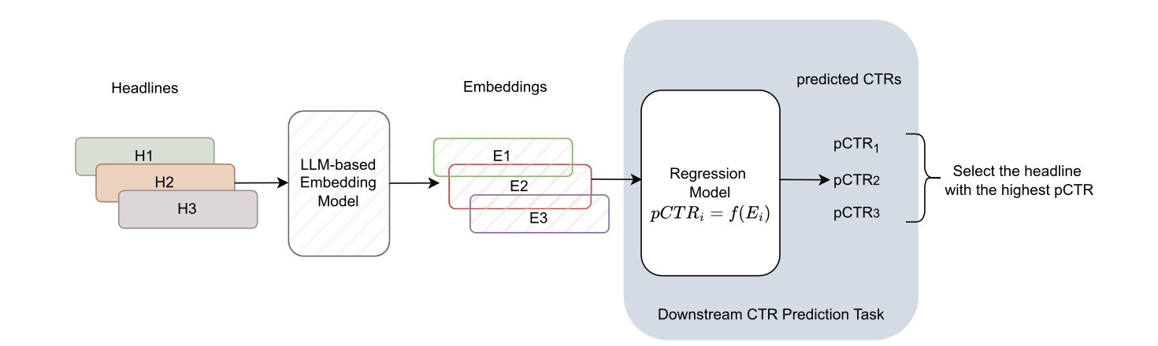
Embedding-Based CTR Prediction Framework
The third approach represents a fundamentally different paradigm: rather than asking the LLM to directly predict the best headline, this method uses LLMs as feature extractors to create rich semantic embeddings, which are then fed into traditional supervised learning models for CTR prediction.
Step 3: Prediction & Selection
Step 2: Model Training
For each new A/B test, generate embeddings for all headline options, predict CTR for each using the trained model, and select the headline with the highest predicted CTR.
Step 1: Embedding Generation
Use the generated embeddings as input features for supervised machine learning models. The researchers tested both linear regression and multilayer perceptron (MLP) architectures, training on historical headline-test pairs with known CTR outcomes.
Convert each headline into a dense vector representation using OpenAI's embedding model. The embedding captures semantic meaning, tone, sentiment, and other linguistic features in a fixed-dimensional space.

Slide 9
Embedding-Based Results
The following table summarizes performance across different embedding dimensionality and model architectures:
Embedding Model
Architecture
Accuracy
256-dimensional
Linear regression
~46.28% (46.12%)
256-dimensional
Multilayer perceptron (MLP)
~44.00%
3072-dimensional
Linear regression
~43.00%
3072-dimensional
Multilayer perceptron (MLP)
~45.00%
Key Observations
Supervised Learning Advantage
Linear Models Compete Well
Embedding-based models achieved 43-46% accuracy, substantially outperforming prompting methods (37-40%). This demonstrates the value of learning from large labeled datasets rather than relying solely on LLM general knowledge.
Simple linear regression performed competitively with more complex MLP architectures, suggesting that the embedding space captures features that are largely linearly separable for this task.
Dimensionality Not Critical
Architecture Trade-offs
Higher-dimensional embeddings (3072-dim) did not consistently outperform lower-dimensional ones (256-dim), indicating that the additional dimensions may contain noise or irrelevant information for headline prediction.
MLPs showed slightly better performance with 3072-dim embeddings but worse with 256-dim, suggesting complex models require sufficient feature dimensionality to avoid overfitting on limited signal.

Slide 10




Interpretation of Embedding Results
Why Embeddings Outperformed Prompting
Large Labeled Dataset
Supervised learning leveraged 17,681 labeled tests, enabling the model to learn patterns specific to headline appeal rather than relying on general knowledge
Despite the improvements, accuracy remains below 50%, meaning models still fail to identify the best headline more than half the time. This indicates that LLMs alone cannot fully replace experimentation in high-stakes content decisions.
Task-Specific Decision Rules
The model learned which embedding dimensions and combinations predict high CTR in this specific domain
Robust Generalization
Training on diverse headline sets created models that generalize better to new, unseen headline variations
No Few-Shot Limitation
Unlike in-context learning, supervised models aren't constrained by the number of demonstrations that fit in the prompt
Implications for Practice
Cost-Effectiveness
Hybrid Approaches
Refined Features
Embedding-based models could reduce experimentation costs by pre-screening poor headline options, though complete replacement remains impractical
Future work should explore LOLA (LLM-Assisted Online Learning Algorithm) frameworks that combine LLM predictions with bandit algorithms for adaptive traffic allocation
Performance might improve with domain-specific embeddings trained on headline data rather than generic OpenAI embeddings
Future Research Directions
Testing fine-tuned LLM architectures on this dataset
Developing LOLA frameworks that integrate LLM predictions with online learning
Exploring cold-start solutions for new content categories
Validating findings on news headline datasets with shorter time horizons
Investigating multi-modal approaches incorporating article content and images

Slide 11
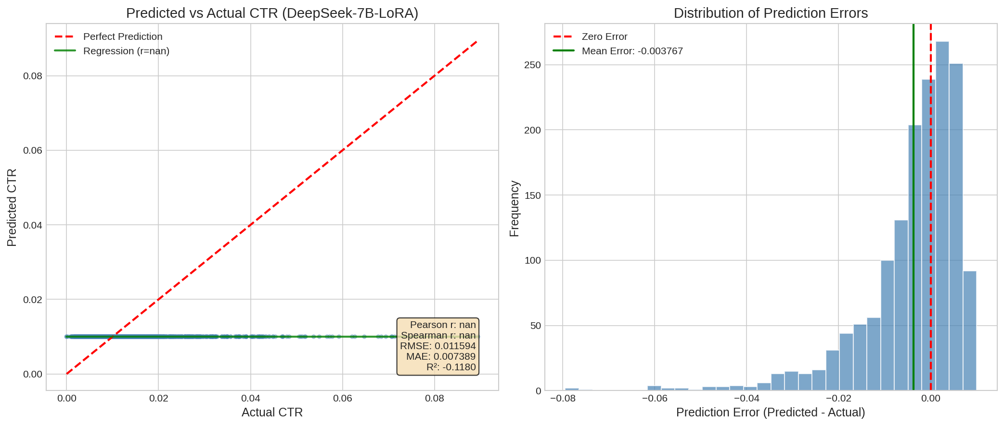
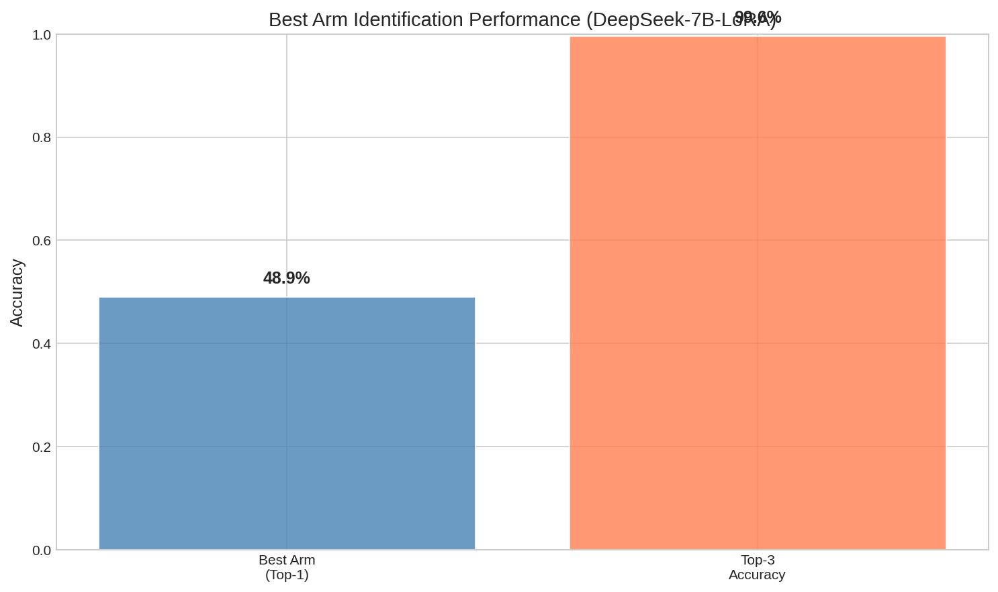
Fine-Tuning Open-Source LLMs with LoRA
If we can train LLMs directly, can we achieve better performance?
The goal of fine-tuning is to adapt a general-purpose LLM for specific downstream tasks through a process typically involving supervised learning using labeled datasets.
Low-Rank Adaptation (LoRA), a popular Parameter-Efficient FineTuning (PEFT) method, benefiting saving memory usage and computing resources.
Finetuned model: Llama-3-70b vs deepseek-7b-chat (our foundation model)

Slide 12
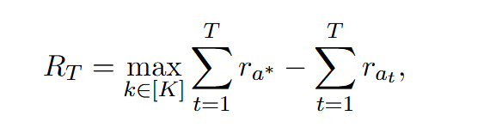
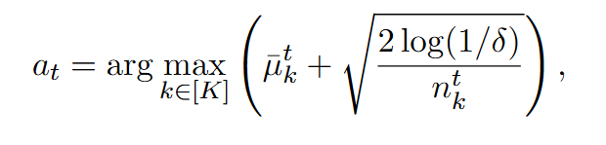
A Novel Approach—LOLA: LLM-Assisted Online Learning Algorithm
A framework that combines the benefits of LLM-based models with experimentation-based methods.
that firms can address the cold-start problem in content experiments by leveraging predictions from LLM-based approaches as CTR priors in the first step;
and combining them with an online learning algorithm in the second step.
Multi-Armed-Bandits (MAB) is a class of sequential decision-making problems where a learner must choose between multiple arms over periods to maximize cumulative reward.
In MAB settings with finite arms, the standard algorithm that is typically used is the Upper Confidence Bound (UCB) algorithm (Auer et al., 2002).
Notes:
The learner’s goal is to minimize cumulative regret, which is defined as the difference between the reward obtained by always choosing the optimal arm and the reward actually accumulated by the learner under the policy played by the learner.
UCB ensures that arms with fewer selections (higher uncertainty) are given a chance to be explored.
The UCB policy is straightforward – it selects the arm that maximizes the upper confidence bound on the estimated rewards.

Slide 13
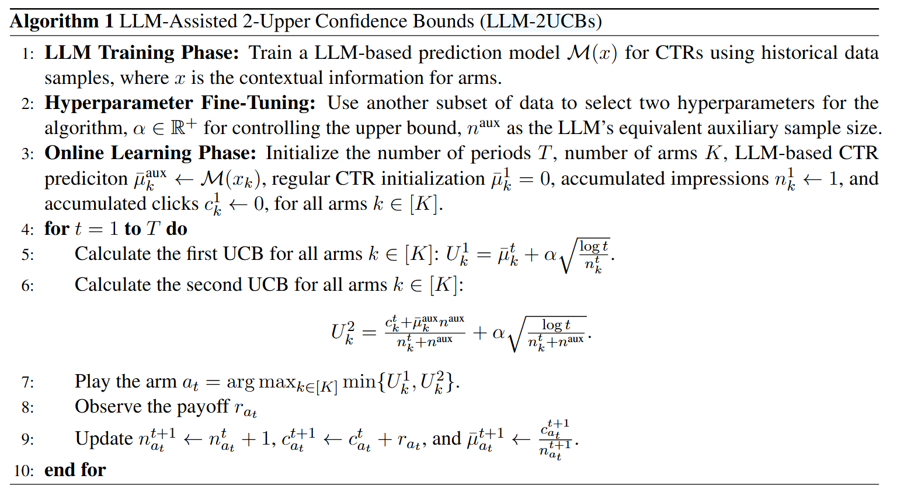
A Novel Approach—LOLA: LLM-Assisted Online Learning Algorithm
we select the best-performing approach, LoRA fine-tuned model, as the best CTR prediction model in the first step.
In the second step, we build on the bandit framework to design an online algorithm that incorporates the LLM-based CTR predictions from the first step.
Notes:
in this algorithm, we treat the LLM’s CTR predictions as auxiliary information prior to the start of online experiments, equating this auxiliary CTR information to additional impressions and click outcomes for each arm.
There are two hyperparameters in LLM-2UCBs – (1) The upper bound control hyperparameter, α, that also shows up in the regular UCB algorithm, and
(2) The hyperparameter n^aux, which is specific to our proposed algorithm and indicates the equivalent auxiliary samples for initialization.

Slide 14
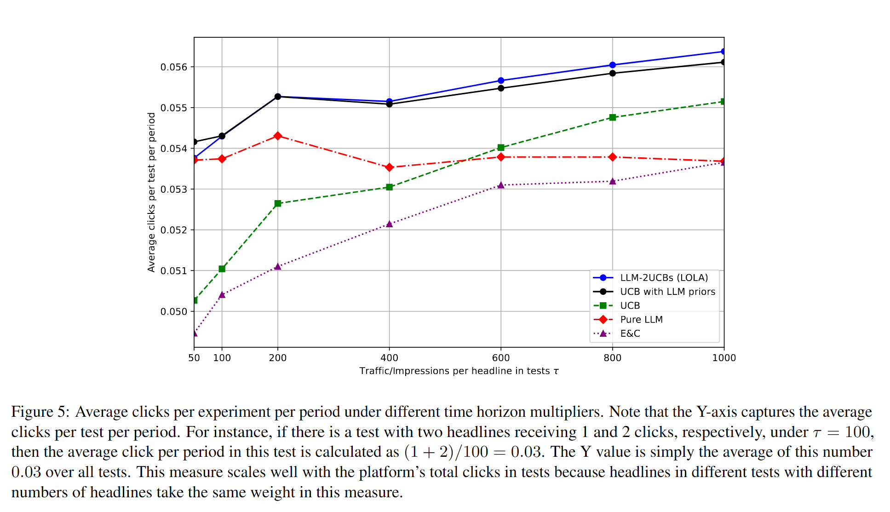
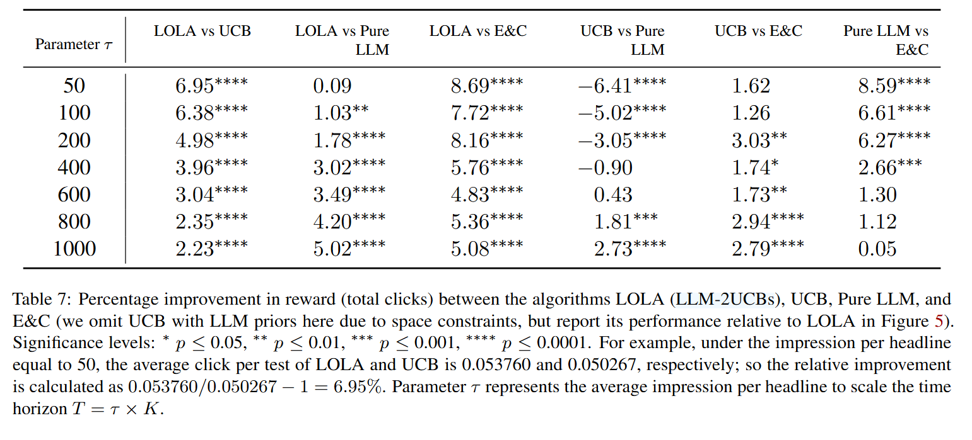
Results of LOLA
Benchmarks: Explore-then-Commit (E&C); Pure LLM-based approach; Standard UCB (UCB); UCB with LLM priors.
LOLA: LLM-2UCBs
Findings:
LOLA generally outperforms Pure LLM, except when τ = 50.
LOLA always outperforms UCB. As the time horizon increases, the relative improvement from LOLA diminishes.
LOLA outperforms both UCB and pure LLM method and provides superior performance in both short and long horizons
As the time horizon increases (e.g., τ = 800 and τ = 1000), LOLA significantly outperforms UCB.

Slide 15
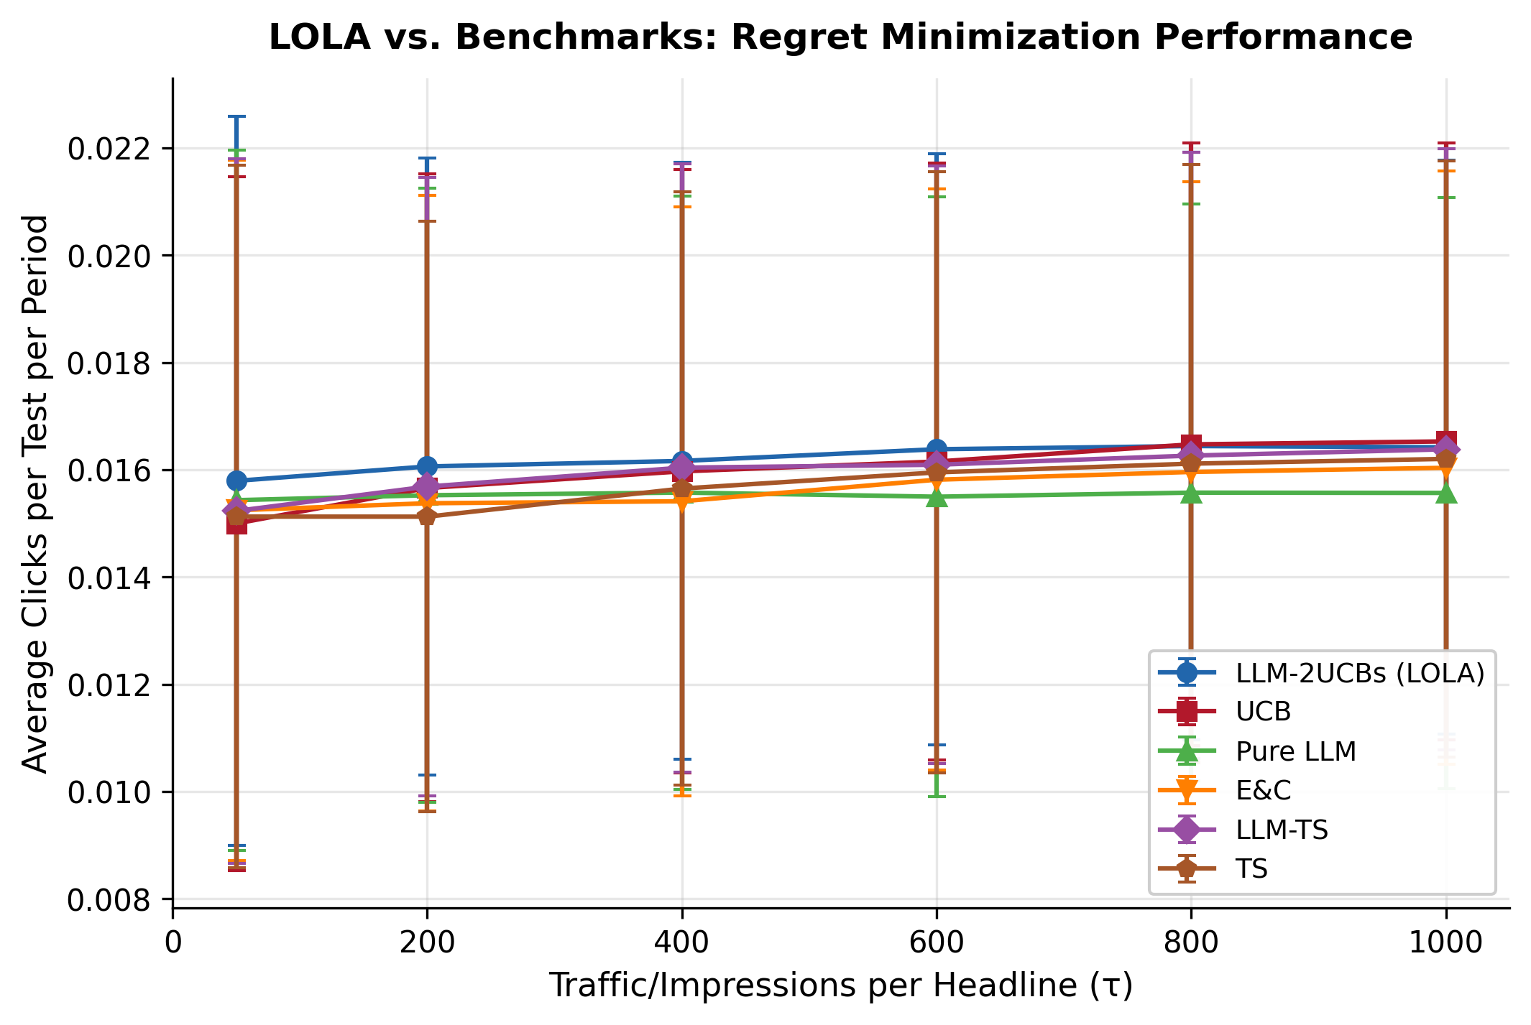
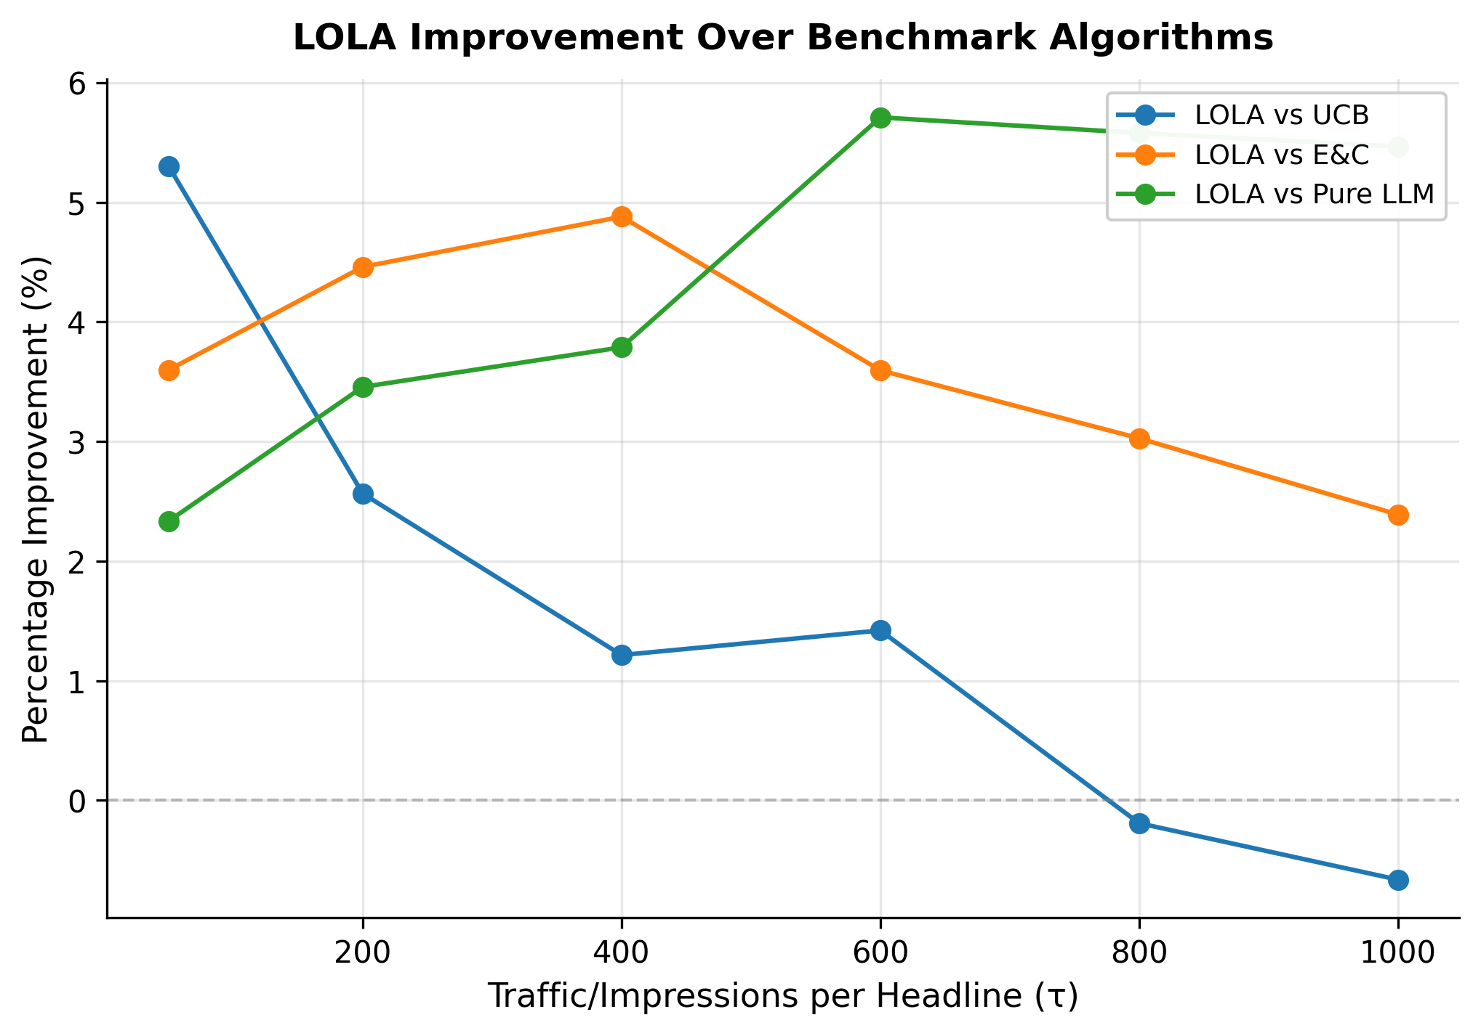
Replication Results of LOLA
Our replication results (ten percent samples of test data) of LOLA keep consistent with that in the original paper. Additionally, we extended LOLA to Best Arm Identification (BAI) and Thompson Sampling (TS). The results show that:
We did not get the same level of improvement of LOLA compared to the original paper. However,
As the time horizon (tau) increases, the improvement of LOLA over pure LLM is increasing;
the improvement of LOLA over UCB and E&C diminishes with tau increases.

Slide 16
LOLA: LLM-Assisted Online Learning Algorithm for Content Experiments
Ye, Yoganarasimhan, Zheng | Marketing Science, 2025
Replicated and Presented by Xizhi Liu and Shaoqiang Liu | DOTE6635, 2026
Thank you for attentions!

